Slide 2

Slammers Beach Volleyball Website development lifecycle
Project Start
Meet with client and obtain requirements and specifications
Develop Mission Statement, Project Lifecycle chart, Budget. Meet with client and obtain signoff
Source information and images. Create design and taxonomy concepts
Create graphic design and page template
Meet with client and obtain feedback on concepts, design and templates
Revise as needed from feedback
Construction and content development
Client review and user testing
Publish and promote website
Carry out ongoing maintenance & update of site
Project Lifecycle
Week 0
Week 1
Week 2
Week 3
Week 4
Week 5
Week 6

Slide 3
Slammers Beach Volleyball Website Flowchart
Home
Welcome to Slammers Beach Volleyball Club
Playing Volleyball
Volleyball Competitions
About Volleyball
Playing Guidelines
Object of the Game
Did You Know
Useful Links
Announcements, Bar & Food Menus & Functions
Announcements
Bar Menu
Snack Menu
Booking Functions
Sign Up
Registration Form
Contact Us, Location Map, Hours Open
Address, Phone & Email Details
Hours Open
Map with Directions

Slide 4

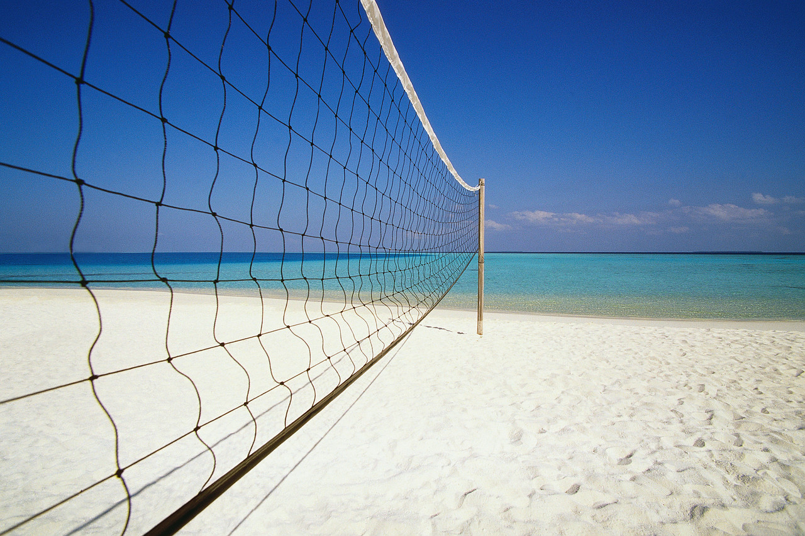


Home Playing Volleyball About Volleyball Announcements, Bar Hours & Functions Contact Us & Location Map
Welcome to Slammers Beach Volleyball Club
The Health Club With it All
We are passionate about beach volleyball. Playing the game promotes health, fitness and is one of the only team sports which can be played by people of all ages. At Slammers you can play volleyball as a family, competitively or just for having fun with friends. Next time at the beach drop in and check us out.
Our premium playing facilities are complimented with other services such as a licensed bar which serves healthy meals. Also, if you are looking for a venue for a function we have just the place.
Did you know Slammers was voted “Cairnsvilles BEST Club Sports Facility”!

Slide 5

Home Playing Volleyball About Volleyball Announcements, Bar Hours & Functions Contact Us & Location Map
Welcome to Slammers Beach Volleyball Club
The Health Club With it All
We are passionate about beach volleyball. Playing the game promotes health, fitness and is one of the only team sports which can be played by people of all ages. At Slammers you can play volleyball as a family, competitively or just for having fun with friends. Next time at the beach drop in and check us out.
Our premium playing facilities are complimented with other services such as a licensed bar which serves healthy meals. Also, if you are looking for a venue for a function we have just the place.
Did you know Slammers was voted “Cairnsvilles BEST Club Sports Facility”!

Slide 6
Home Playing Volleyball About Volleyball Announcements, Bar Hours & Functions Contact Us & Location Map
Welcome to Slammers Beach Volleyball Club
The Health Club With it All
We are passionate about beach volleyball. Playing the game promotes health, fitness and is one of the only team sports which can be played by people of all ages. At Slammers you can play volleyball as a family, competitively or just for having fun with friends. Next time at the beach drop in and check us out.
Our premium playing facilities are complimented with other services such as a licensed bar which serves healthy meals. Also, if you are looking for a venue for a function we have just the place.
Did you know Slammers was voted “Cairnsvilles BEST Club Sports Facility”!

Slide 7
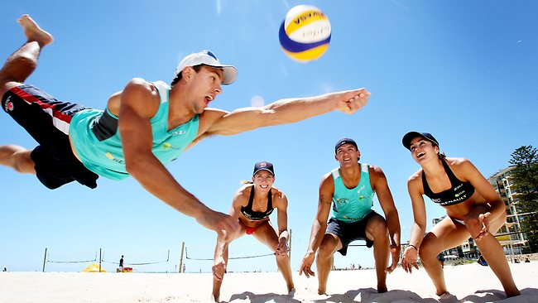
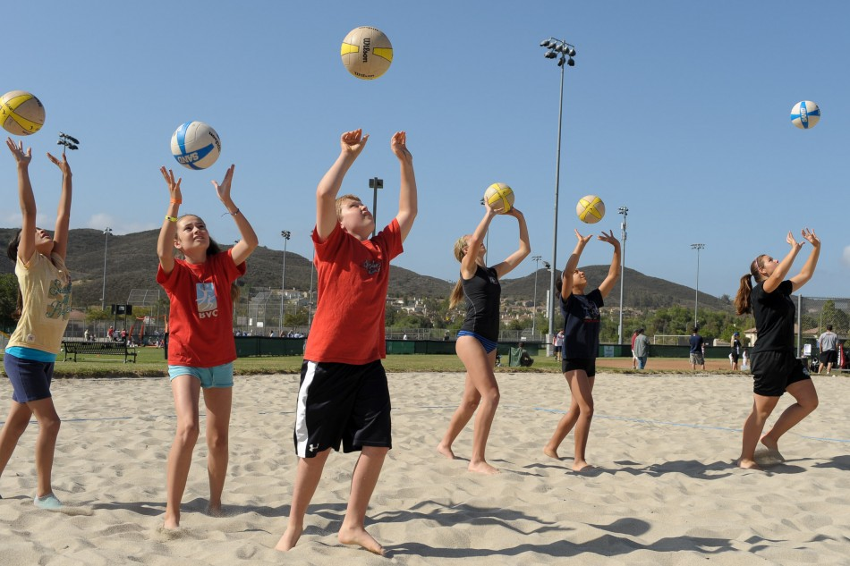
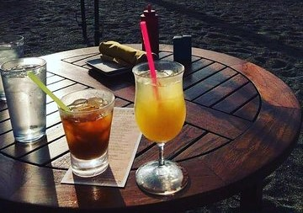
Home Playing Volleyball About Volleyball Announcements, Bar Hours & Functions Contact Us & Location Map
Welcome to Slammers Beach Volleyball Club
The Health Club With it All
We are passionate about beach volleyball. Playing the game promotes health, fitness and is one of the only team sports which can be played by people of all ages. At Slammers you can play volleyball as a family, competitively or just for having fun with friends. Next time at the beach drop in and check us out.
Our premium playing facilities are complimented with other services such as a licensed bar which serves healthy meals. Also, if you are looking for a venue for a function we have just the place.
Did you know Slammers was voted “Cairnsvilles BEST Club Sports Facility”!

Slide 8
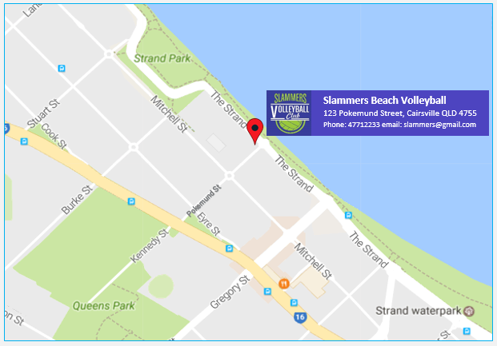
Home Playing Volleyball About Volleyball Announcements, Bar Hours & Functions Contact Us & Location Map
Slammers Beach Volley Ball – Next to the Iconic Cairsville Strand
Address: 123 Pokemund Street, Cairnsville QLD
Phone: 47712233
Fax: 47712244
Email: slammers@gmail.com
Staffed Hours
Monday – Thursday
10.00am – 8.00pm
Friday – Saturday
6.00am – 10.00pm

Slide 9
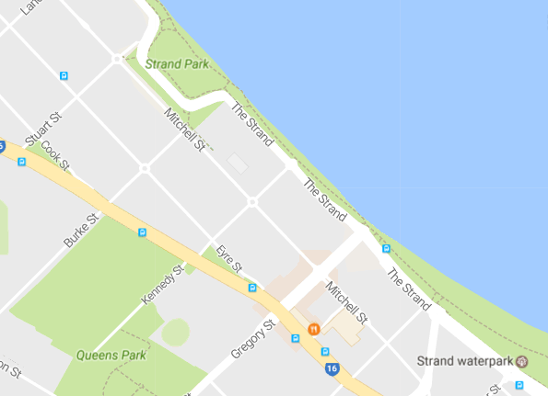


Slammers Beach Volleyball
123 Pokemund Street, Cairsville QLD 4755 Phone: 47712233 email: slammers@gmail.com
Pokemund St

